Slide 1
GRADE 7 ACCELERATED · UNIT 3 · LESSON 2
Quotient Laws of Exponents
MA.7.NSO.1.1
I can use the quotient of powers, power of a quotient and zero exponent laws to rewrite and evaluate a numerical expression.
Yesterday: same base, add the exponents.
Today: same base, subtract — and exponent 0 is not 0.
Grade 7 Accelerated · Unit 3 · Lesson 2 — Quotient Laws of Exponents
1

Slide 2



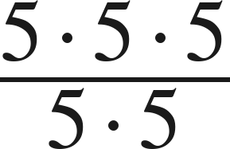
Warm-Up
On your own. Four minutes. No notes.
1. Write as one power:
2.
3. Solve
4. Simplify
Grade 7 Accelerated · Unit 3 · Lesson 2 — Quotient Laws of Exponents
2

Slide 3

Warm-Up
Answers.
1. Write as one power:
2.
−3
3. Solve
x < 4
4. Simplify
5
Grade 7 Accelerated · Unit 3 · Lesson 2 — Quotient Laws of Exponents
3

Slide 4
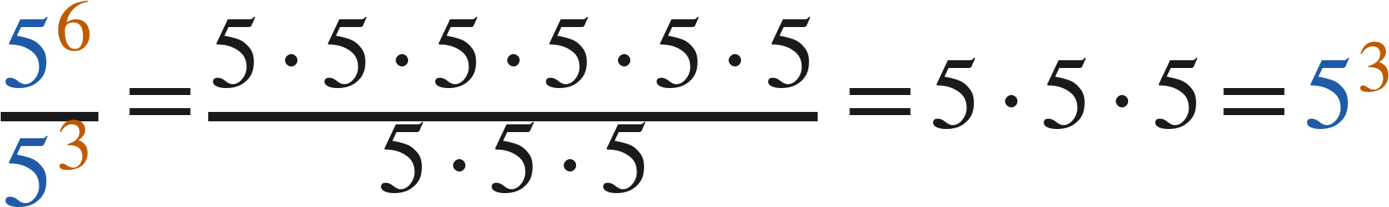
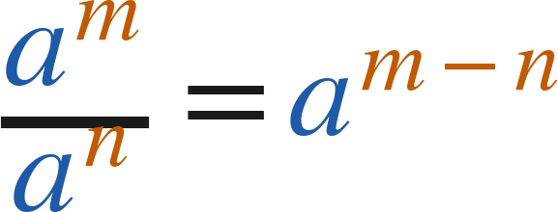

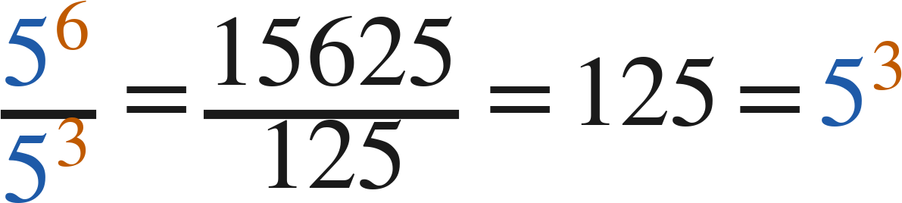
Notes
Where the rule comes from.
I. Quotient of powers — same base, subtract the exponents
Quotient of powers:
(
)
Check with values:
Grade 7 Accelerated · Unit 3 · Lesson 2 — Quotient Laws of Exponents
4

Slide 5
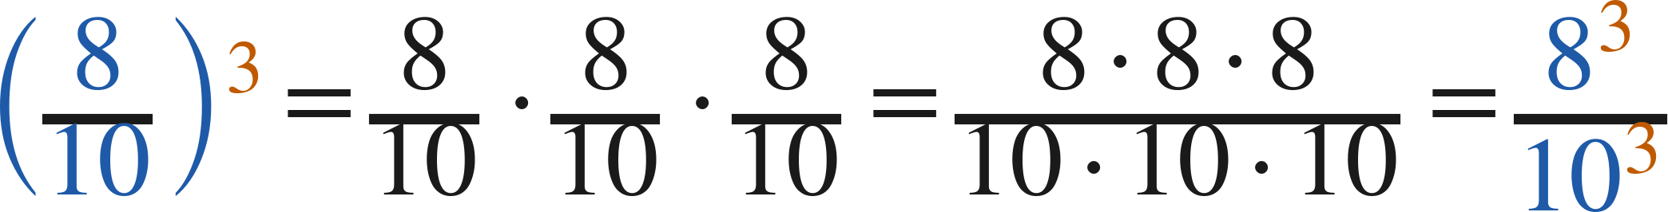
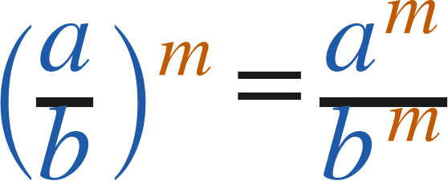
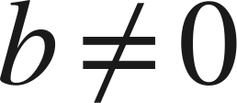
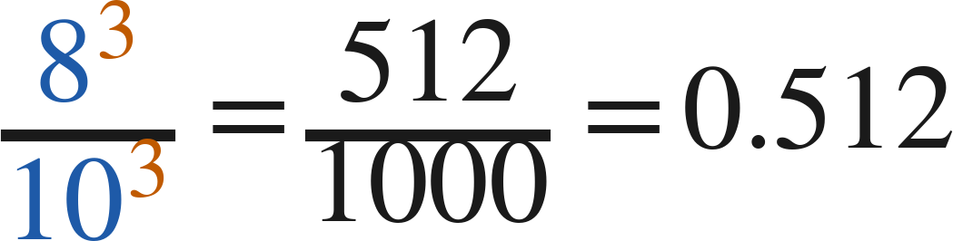

Notes
II. Power of a quotient — the exponent goes top and bottom
Power of a quotient:
(
)
Either way:
and
Grade 7 Accelerated · Unit 3 · Lesson 2 — Quotient Laws of Exponents
5

Slide 6
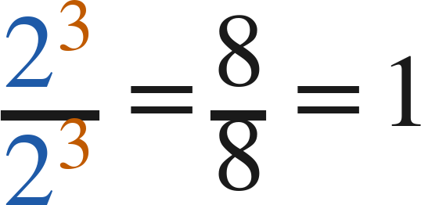
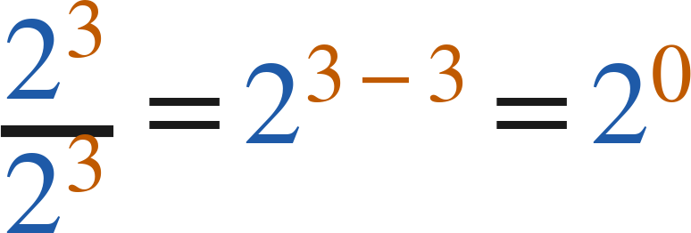

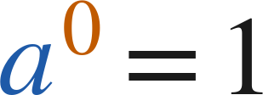

Notes
III. The zero exponent — two roads to the same answer
2⁴ | 2³ | 2² | 2¹ | 2⁰
16 | 8 | 4 | 2 | 1
and
so
Zero exponent:
for every nonzero
Grade 7 Accelerated · Unit 3 · Lesson 2 — Quotient Laws of Exponents
6

Slide 7
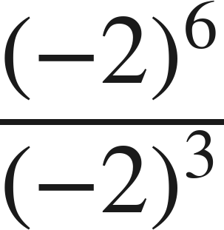
Example 1
A negative base.
Which law? Then find the value.
Grade 7 Accelerated · Unit 3 · Lesson 2 — Quotient Laws of Exponents
7

Slide 8
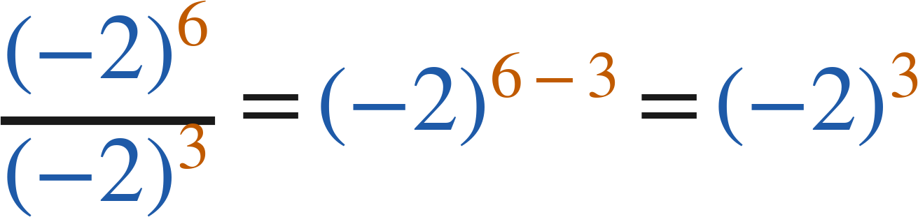
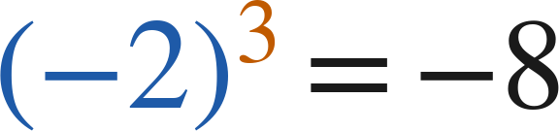
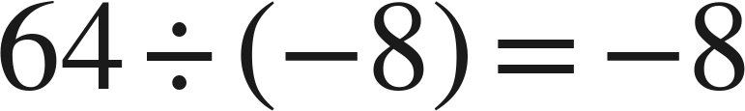
Example 1
Worked.
quotient of powers: subtract
three negative factors
check: evaluate each, then divide
Answer: −8
Grade 7 Accelerated · Unit 3 · Lesson 2 — Quotient Laws of Exponents
8

Slide 9
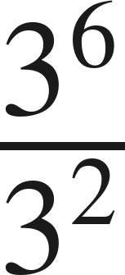
Your Turn
Same steps, your numbers. Boards up when done.
Grade 7 Accelerated · Unit 3 · Lesson 2 — Quotient Laws of Exponents
9

Slide 10

Your Turn
Answer.
same base, subtract: 3⁴
Answer: 3⁴ = 81
Grade 7 Accelerated · Unit 3 · Lesson 2 — Quotient Laws of Exponents
10

Slide 11
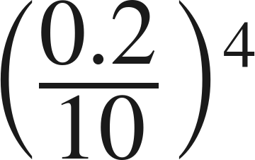
Example 2
A decimal base inside a quotient.
Find the value.
Grade 7 Accelerated · Unit 3 · Lesson 2 — Quotient Laws of Exponents
11

Slide 12
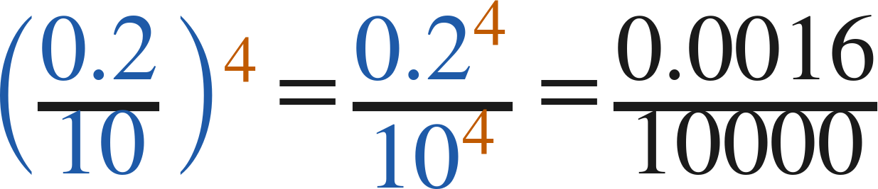
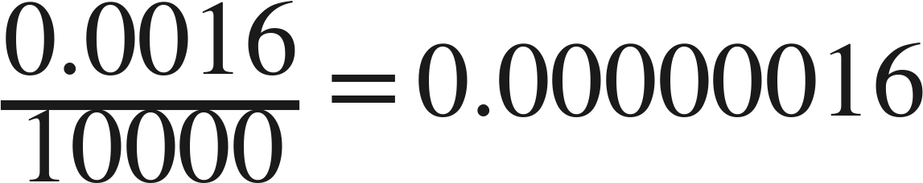

Example 2
Worked both ways.
power of a quotient
divide by 10⁴: four places left
check: divide first, then raise
Answer: 0.00000016
Grade 7 Accelerated · Unit 3 · Lesson 2 — Quotient Laws of Exponents
12

Slide 13
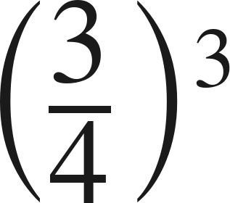
Your Turn
Same steps, your numbers. Boards up when done.
Grade 7 Accelerated · Unit 3 · Lesson 2 — Quotient Laws of Exponents
13

Slide 14
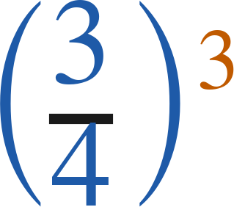

Your Turn
Answer.
numerator and denominator both cubed
Answer:
Grade 7 Accelerated · Unit 3 · Lesson 2 — Quotient Laws of Exponents
14

Slide 15
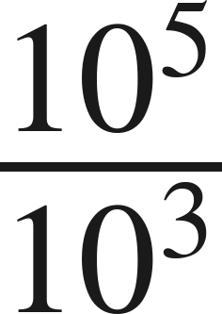
Whiteboards · Question 1 of 9
Boards up on three.
Answer it.
Write it as one power.
Grade 7 Accelerated · Unit 3 · Lesson 2 — Quotient Laws of Exponents
15

Slide 16
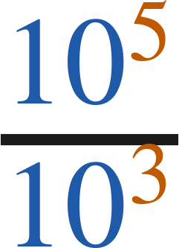

Whiteboards · Question 1 of 9
Answer.
same base, subtract the exponents
Answer:
Grade 7 Accelerated · Unit 3 · Lesson 2 — Quotient Laws of Exponents
16

Slide 17


Whiteboards · Question 2 of 9
Boards up on three.
A server stores
files in
folders, evenly.
It has been running for 30 days.
How many files are in each folder?
Answer it.
Find the value.
Grade 7 Accelerated · Unit 3 · Lesson 2 — Quotient Laws of Exponents
17

Slide 18


Whiteboards · Question 2 of 9
Answer.
A server stores
files in
folders, evenly.
It has been running for 30 days.
How many files are in each folder?
8⁴ ÷ 8¹ = 8³
Answer: 512
Grade 7 Accelerated · Unit 3 · Lesson 2 — Quotient Laws of Exponents
18

Slide 19
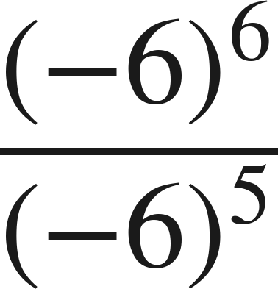
Whiteboards · Question 3 of 9
Boards up on three.
Answer it.
Find the value.
Grade 7 Accelerated · Unit 3 · Lesson 2 — Quotient Laws of Exponents
19

Slide 20
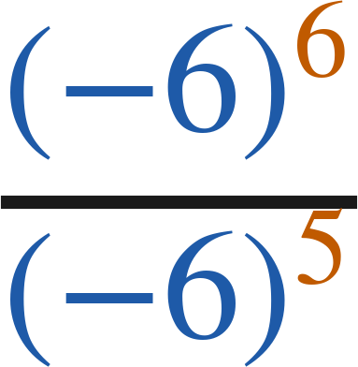
Whiteboards · Question 3 of 9
Answer.
(−6)¹
Answer: −6
Grade 7 Accelerated · Unit 3 · Lesson 2 — Quotient Laws of Exponents
20

Slide 21
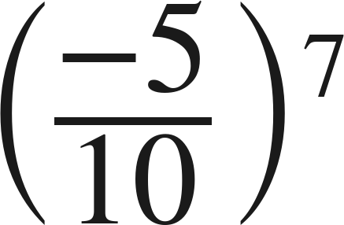
Whiteboards · Question 4 of 9
Boards up on three.
Answer it.
Apply the power of a quotient law. Do not simplify.
Grade 7 Accelerated · Unit 3 · Lesson 2 — Quotient Laws of Exponents
21

Slide 22
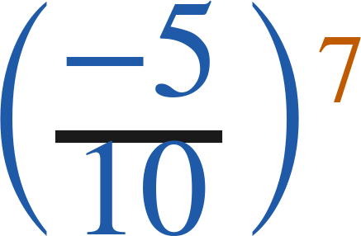
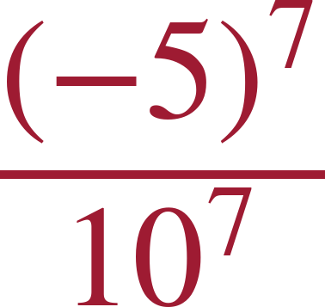
Whiteboards · Question 4 of 9
Answer.
the exponent goes to both
Answer:
Grade 7 Accelerated · Unit 3 · Lesson 2 — Quotient Laws of Exponents
22

Slide 23

Whiteboards · Question 5 of 9
Boards up on three.
Which is the value?
A. 1
B. 0
C. 9
D. 1/9
Answer it.
Grade 7 Accelerated · Unit 3 · Lesson 2 — Quotient Laws of Exponents
23

Slide 24

Whiteboards · Question 5 of 9
Answer.
Which is the value?
A. 1
B. 0
C. 9
D. 1/9
Answer: A — 1
Grade 7 Accelerated · Unit 3 · Lesson 2 — Quotient Laws of Exponents
24

Slide 25
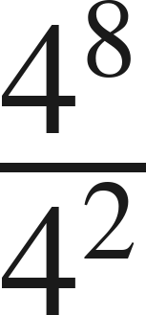
Whiteboards · Question 6 of 9
Boards up on three.
Which expression is equivalent?
A. 4⁶
B. 4⁴
C. 1⁶
D. 4¹⁰
Answer it.
Grade 7 Accelerated · Unit 3 · Lesson 2 — Quotient Laws of Exponents
25

Slide 26

Whiteboards · Question 6 of 9
Answer.
Which expression is equivalent?
A. 4⁶
B. 4⁴
C. 1⁶
D. 4¹⁰
Answer: A — 4⁶
Grade 7 Accelerated · Unit 3 · Lesson 2 — Quotient Laws of Exponents
26

Slide 27
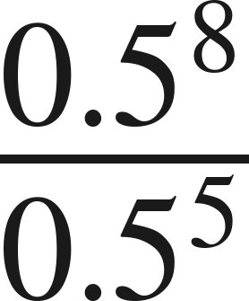
Whiteboards · Question 7 of 9
Boards up on three.
Answer it.
Find the value.
Grade 7 Accelerated · Unit 3 · Lesson 2 — Quotient Laws of Exponents
27

Slide 28
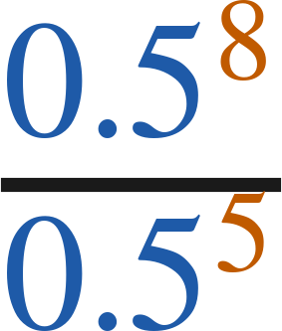
Whiteboards · Question 7 of 9
Answer.
0.5³
Answer: 0.125
Grade 7 Accelerated · Unit 3 · Lesson 2 — Quotient Laws of Exponents
28

Slide 29
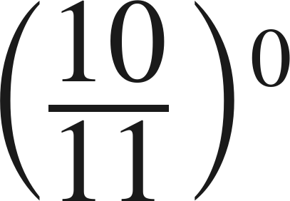
Whiteboards · Question 8 of 9
Boards up on three.
Answer it.
Find the value.
Grade 7 Accelerated · Unit 3 · Lesson 2 — Quotient Laws of Exponents
29

Slide 30
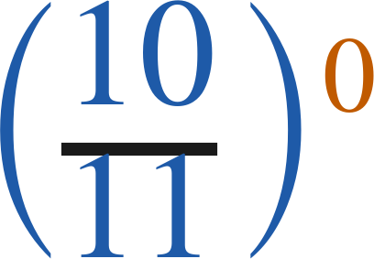
Whiteboards · Question 8 of 9
Answer.
any nonzero base to the zero power
Answer: 1
Grade 7 Accelerated · Unit 3 · Lesson 2 — Quotient Laws of Exponents
30

Slide 31
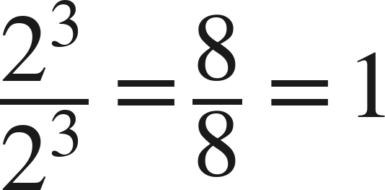
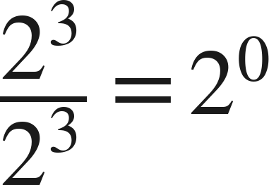
Whiteboards · Question 9 of 9
Take your time. Boards up when you have written it.
Hannah cancels:
. Sebastian subtracts:
.
Who is right?
Write your answer in sentences.
Say what each one did, and what it tells you about 2⁰.
Grade 7 Accelerated · Unit 3 · Lesson 2 — Quotient Laws of Exponents
31

Slide 32
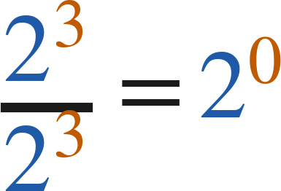
Whiteboards · Question 9 of 9
Answer.
Hannah cancels:
. Sebastian subtracts:
.
Who is right?
both are right, so 2⁰ must equal 1
Answer: Both — 2⁰ = 1
Grade 7 Accelerated · Unit 3 · Lesson 2 — Quotient Laws of Exponents
32

Slide 33
Independent Set
Six questions. On your own, in silence.
1.
Six questions. Work down the page.
2.
Show the step that does the work, not just the answer.
3.
Silence until the six minutes are up.
Grade 7 Accelerated · Unit 3 · Lesson 2 — Quotient Laws of Exponents
33

Slide 34
IXL
Last five minutes.
1.
Open IXL and start today's skills.
2.
Work on paper where the question needs work. The answer box does not show it.
3.
Every skill listed is required, to a SmartScore of 67. Due at the start of the next class.
Today's skills — all required
Powers with negative bases — WFW
Division with exponents — XNC
Identify equivalent expressions involving whole-number exponents — KBE
Grade 7 Accelerated · Unit 3 · Lesson 2 — Quotient Laws of Exponents
34

